Slide 1
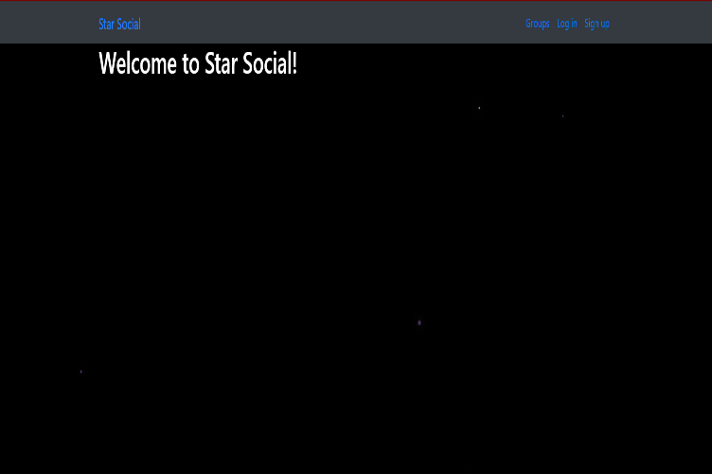
Star Social
Submitted by:-
Department: Training and placement
Faculty: Ram Babu Lovewanshi
Student: Name:Sourabh Raikwar
Enrollment No:0103Ex181095
Branch:EX
Semester:5th
Submitted to:-

Slide 2
DECLARATION
We hereby declare that this project of “Star Social ” has not been copied from anywhere but designed & developed by us through the help of our college faculties for which we are very thankful of them.
Student Name: Sourabh Raikwar
Enrollment No: 0103EX181095

Slide 3
INDEX
Introduction of Organization
History
In Present system
My system
Introduction of the Project
Objective
Requirement
Netbeans IDE 8.2
My Sql
Forms
Report
Limitations
Future Enhancement
Conclusion

Slide 4
Introduction of Organization
When used properly, social media can be a valuable addition to a department's communications strategy. Because many employees have expressed an interest in developing and maintaining a social media presence in personal and professional capacities, the Office of University Communications and Marketing has crafted the following introduction to social media. Please read this overview prior to developing your social media presence.

Slide 5
HISTORY
The first recognizable social media site, Six Degrees, was created in 1997. It enabled users to upload a profile and make friends with other users. In 1999, the first blogging sites became popular, creating a social media sensation that’s still popular today..

Slide 6
IN PRESENT
Nowadays above 85% of all businesses have a dedicated social media platform as part of their marketing strategy.
Nearly 58% of businesses that have used social media marketing for over 3 years and have reported an increase in sales during this period.
Almost 60% of marketers are devoting the equivalent of a full work day to social media marketing for development and maintenance.

Slide 7
MY SYSTEM
Social media gives marketers a voice and a way to communicate with peers, customers, and potential consumers. It personalizes the "brand" and helps you to spread your message in a relaxed and conversational way.

Slide 8
INTRODUCTION OF THE PROJECT
Social media are examples of Web 2.0 technologies, which contrast significantly with the more passive, top-down technologies that characterized Web 1.0 web pages.
Specifically, social media features a rich user experience, dynamic content, scalability, openness and collective intelligence.
Different types of social media include social networks, weblogs, microblogging, content communities, podcasts and wikis.

Slide 9
OBJECTIVE
Brand building – Sharing relevant and helpful information on the right social media channels will help establish your authority as a subject matter expert.
Community building – You are judged by the company you keep. Social networking can help you find and build relationships with other thought leaders and influential individuals and brands.
Relationship building – Your customers and prospects are online talking about brands. Social media can be an effective way to monitor and respond to customer service questions and issues.
Sales building – In some industries, social media can even be effective in generating leads and sales from existing customers and prospects.

Slide 10
REQUIREMENT
HARDWARE
Computer/processor : Intel(R) Core(TM) i5
Memory : 256 MB RAM (128 recommended)
Operating system : windows Operating system.
Peripheral/Miscellaneous: Mouse, keyboard
SOFTWARE REQUIREMENT
Programming : Python 3.7 and ATOM
Database : Sqlite3

Slide 11
ATOM
Atom, GitHub's text editor built on the Electron framework, is being fitted with IDE-like capabilities as a precursor to making the editor a full-fledged IDE. The first step in Atom's transition from text editor to IDE is an optional package of features developed with Facebook called Atom-IDE
Atom enables users to install third-party packages and themes to customize the features and looks of the editor, so you can set it up according to your preferences and with ease (Atom). It is as welcoming to a newbie as it is for an experienced developer

Slide 12
Sqlite
SQLite is a C-language library that implements a small, fast, self-contained, high-reliability, full-featured, SQL database engine. SQLite is the most used database engine in the world. SQLite is built into all mobile phones and most computers and comes bundled inside countless other applications that people use every day
The SQLite file format is stable, cross-platform, and backwards compatible and the developers pledge to keep it that way through the year 2050. SQLite database files are commonly used as containers to transfer rich content between systems [1] [2] [3] and as a long-term archival format for data [4]. There are over 1 trillion SQLite databases in active use

Slide 13
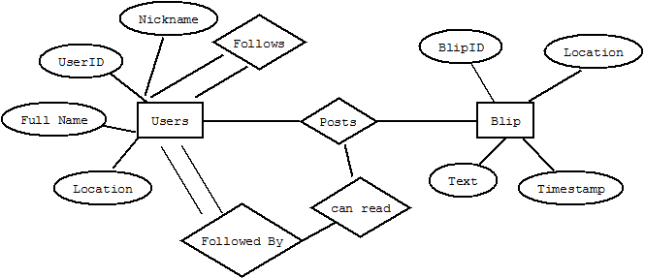
ER-digram

Slide 14
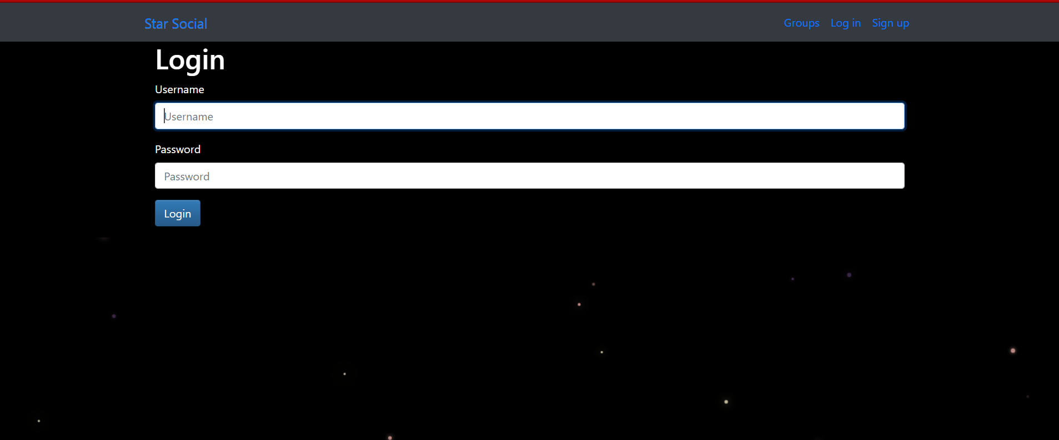
LOGIN FORM

Slide 15
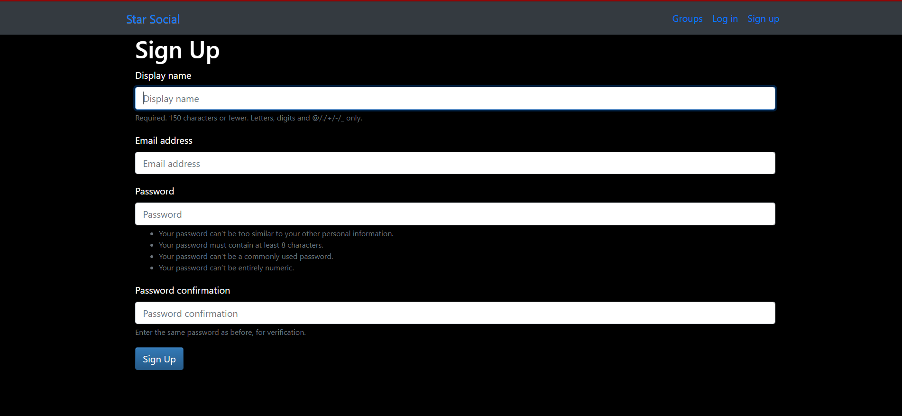
Sign Up

Slide 16
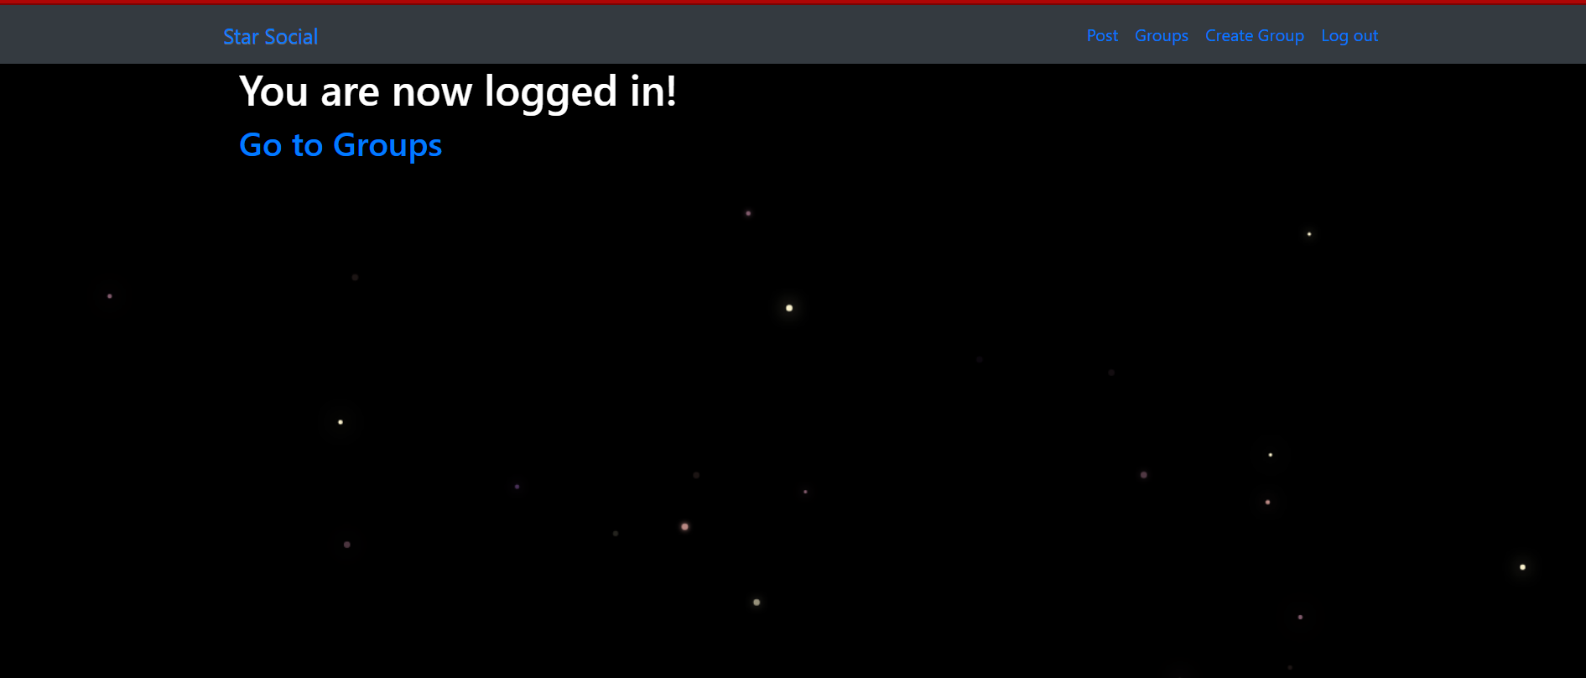
Logged IN

Slide 17
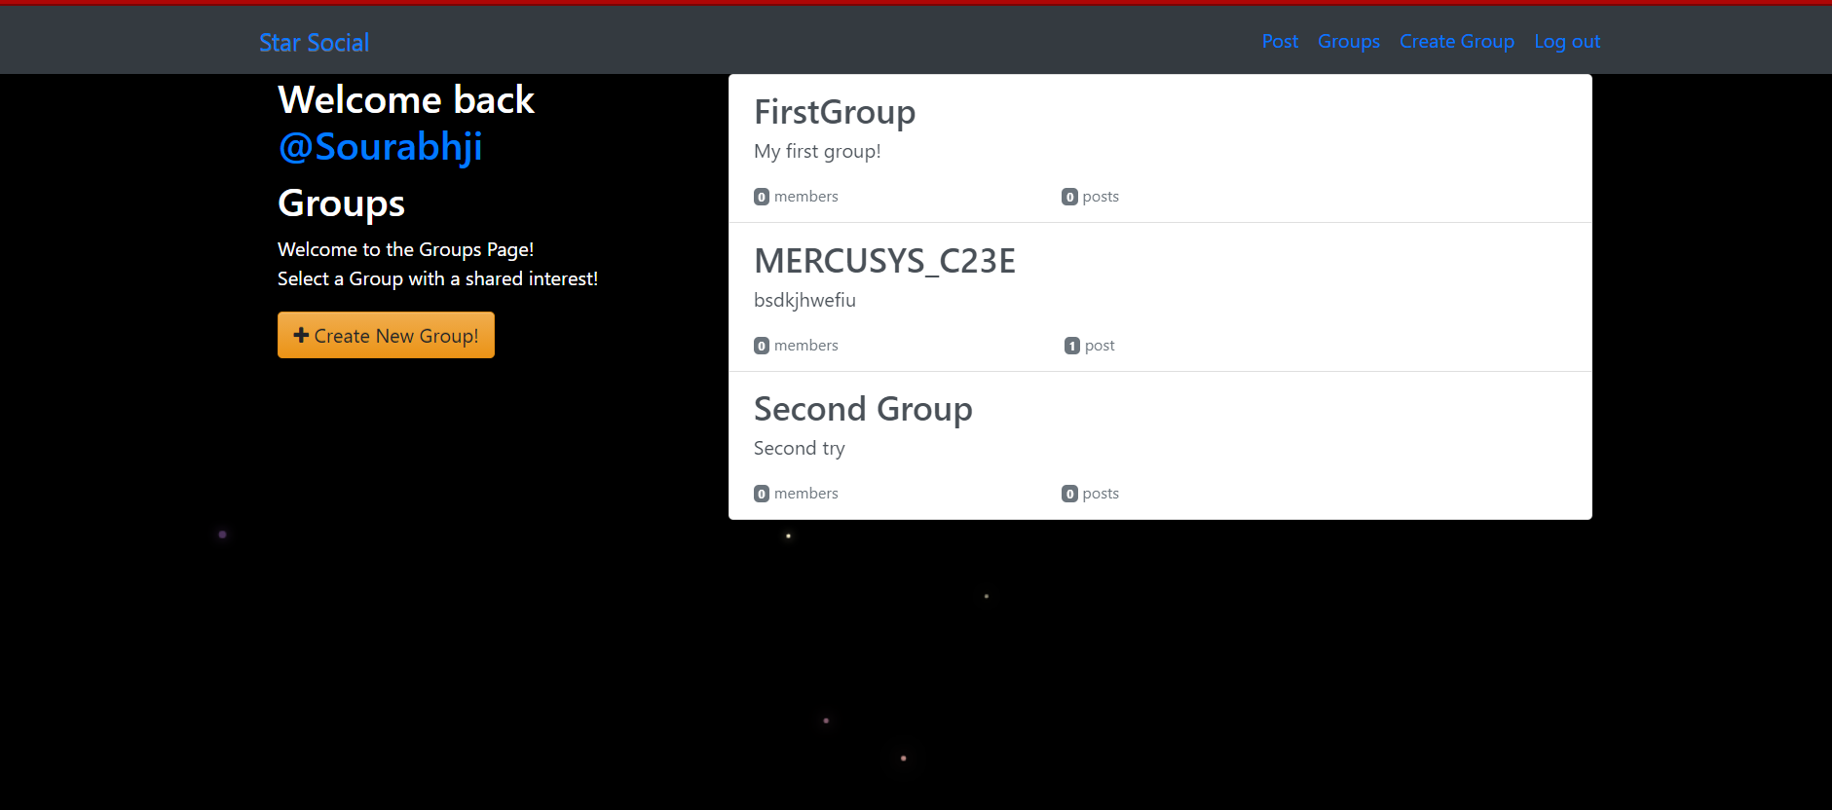
Groups

Slide 18

Main Page

Slide 19
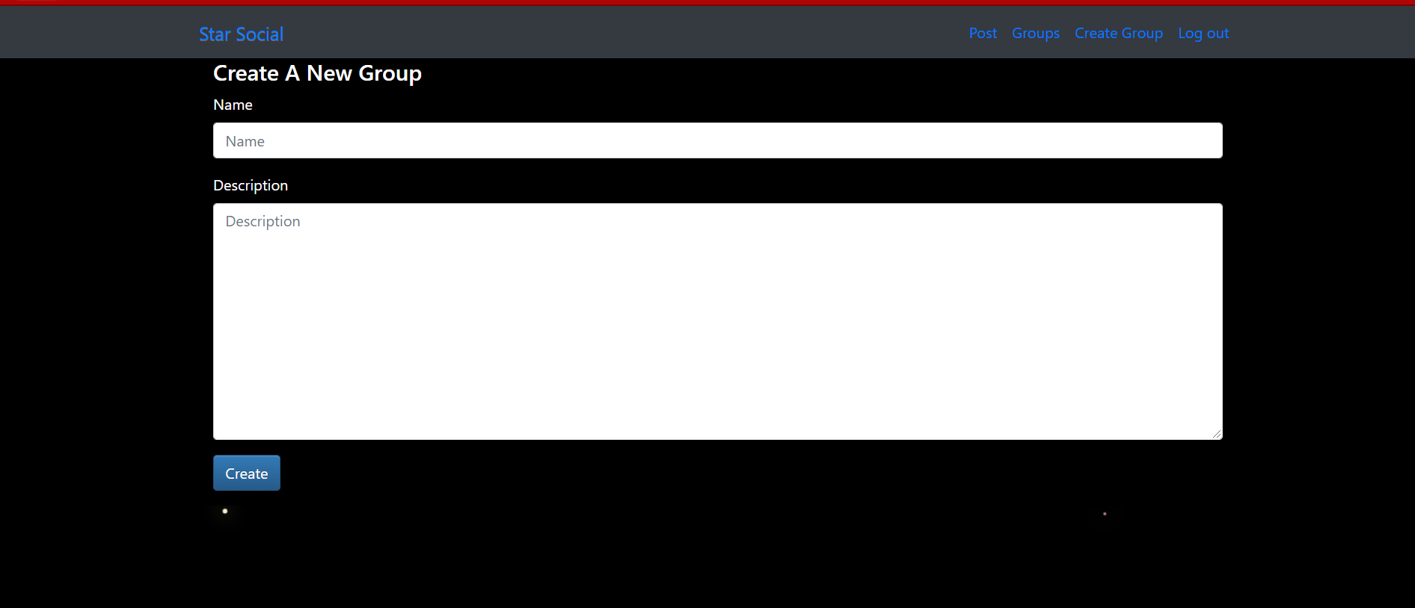
Creating New Group

Slide 20
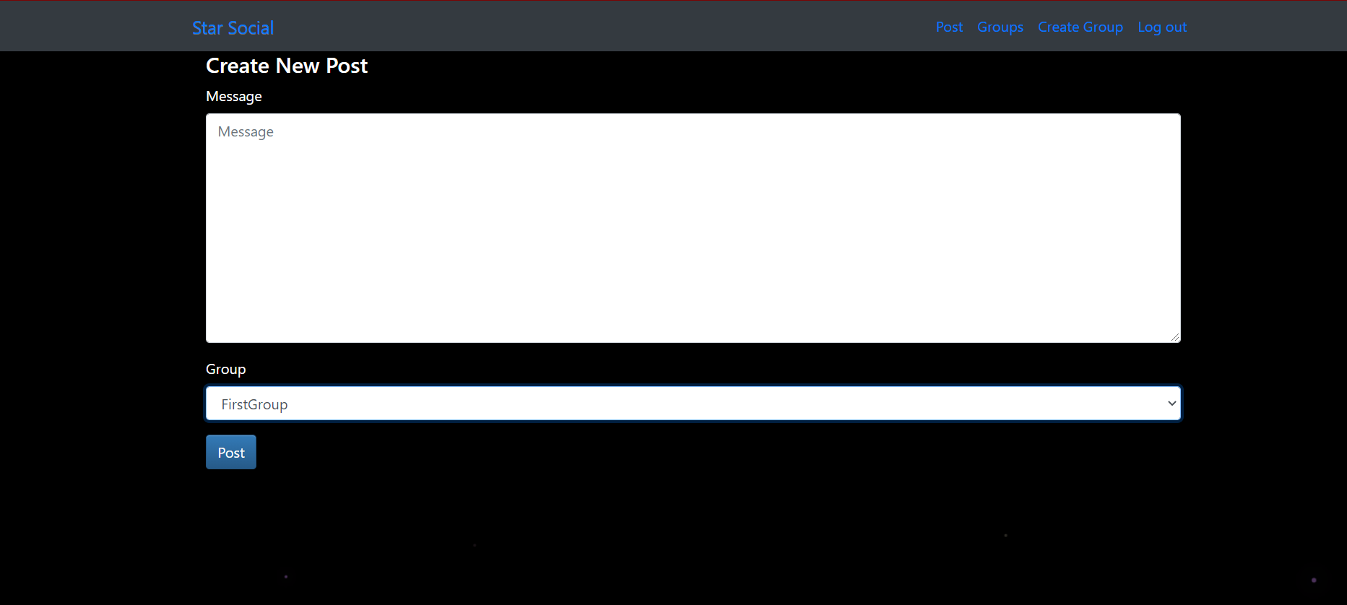
Creating New Post

Slide 21
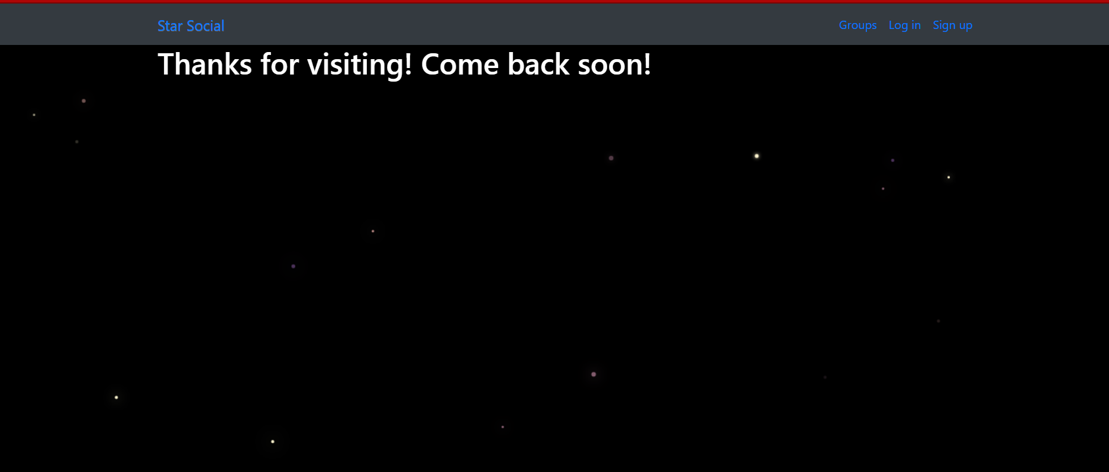
Logout

Slide 22
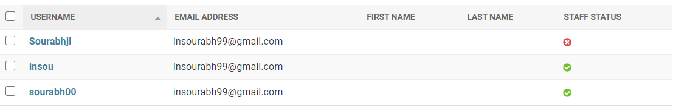
Users Table

Slide 23
Limitations
1. Decreases Face-to-Face Communication Skills.
2. Causes Face-to-Face Interactions to Feel Disconnected.
3. Diminishes Understanding and Thoughtfulness

Slide 24
FUTURE ENHANCEMENT
The scope of social networking is widening, and today it offers a strong support to the companies in providing the much desired touch of concern. Future of social media networking brings exciting promises as expected from the experience of limited users from a few companies in the top bracket.

Slide 25
Conclusion
As social media is too convenient for people, almost most of them don't even have to 'speak out' to communicate with people. No longer, people will lost their communication skills. The more serious problem is many people utilised the power of social media and used it to bully someone

Slide 26
END OF PRESENTATION
THANK YOU

